Slide 1
Part III: Economic measurements

Slide 2
Test your intuition
Which SERP is better?

Slide 3
SERP one
SERP two
Good
Bad
Good
Bad
Bad
Bad
Bad
Good
Bad
Bad
Bad
Bad
Notes:
An easy warmup for people who need warming up.
But even so, once all six are revealed, can you envisage any situation in which SERP 2 catches up?

Slide 4
SERP one
SERP two
Good
Good
Good
Good
Bad
Bad
Bad
Good
Bad
Bad
Bad
Bad
Notes:
Two is at least as good as one
RR says they’re the same

Slide 5
SERP one
SERP two
Bad
Good
Bad
Bad
Bad
Bad
Good
Bad
Good
Bad
Good
Bad
Notes:
P differs to RR for example
Depends on the searcher’s goal.
Like a five set tennis match, it ain’t over till its over.
Maybe it’s never over….

Slide 6
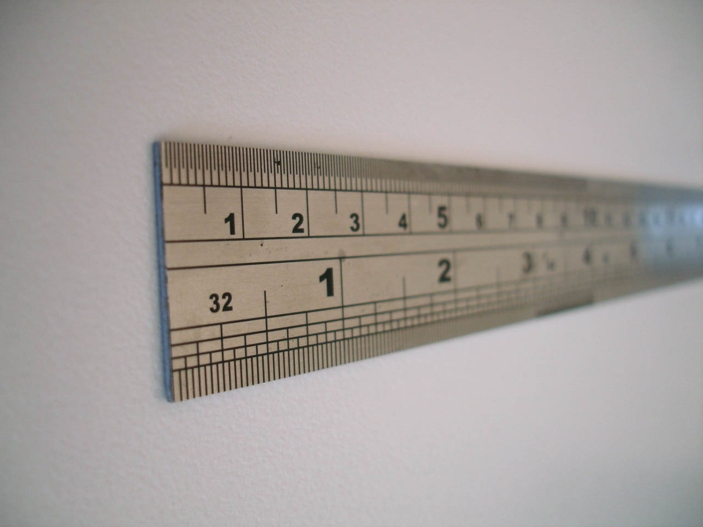
Measuring a SERP: Offline/test collection metrics

Slide 7
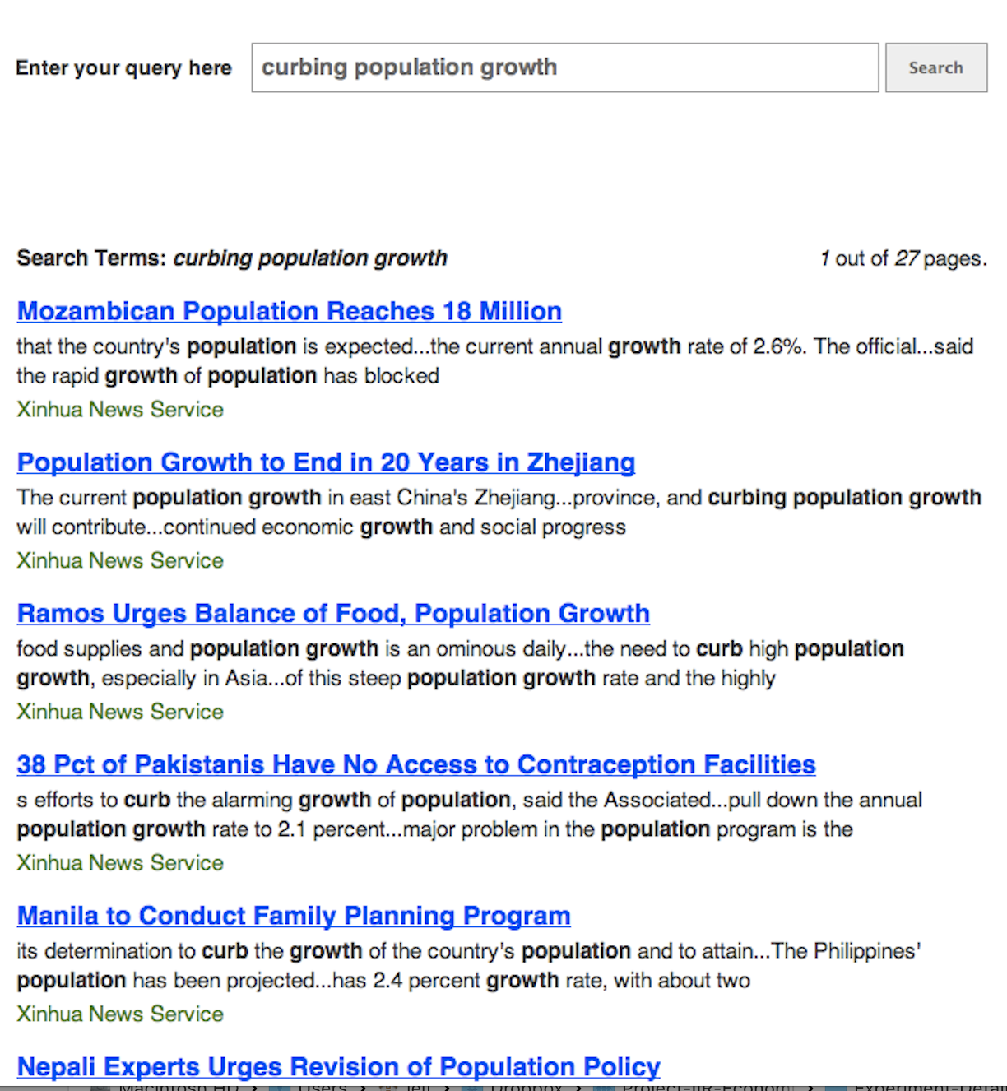






Bad
Bad
Good
Fair
Good
Weight
×
Gain
Notes:
Here’s an example
A list of results
Each has some value – NB we are using “gain” and “utility” interchangeably
User reads down a homogeneous list, less importance/attention to each thing in turn – this is our model
Multiply, that’s our metric

Slide 8
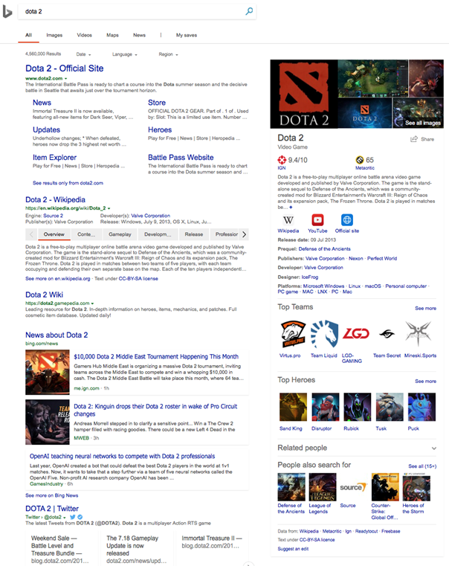
☛
sort of
approximates
☛
Ranked list, top down
Web SERP
Homogenous elements
Notes:
Of course we don’t represent the SERP, just a list of results (URLs)
Because the list of URLs stands for the SERP, the metric somehow stands for the experience
(or the getting-relevant-info part of it)

Slide 9
Why offline?
Cheap
Fast
Repeatable
Tells us about the real experience
?
Notes:
Good for repeated experimentation
We use them ‘cause we believe they have external validity; that is, that they tell us what the real experience would be like; they predict some aspect of the searchers’ experience
They are only as good as they are valid

Slide 10
Metric choices…
P@k, precision at depth k: fraction of the top k which are relevant
RBP, rank-biased precision: geometrically-decreasing importance
RR, reciprocal rank: 1 / rank of the first relevant result
NDCG, normalized discounted cumulative gain: logarithmically- decreasing importance, and scaled by available relevance
AP: average of precision values, at positions where there’s relevance
TBG, ERR, U-measure, Bejewelled, BPref, INSQ, INST …
Notes:
There are lots!
Many in use e.g. at TREC, in SIGIR papers; many many perpetrated in the literature (some by us)
And they all seem to have different units – more on this later
Lots of metrics: anything in common, any coherent way to talk about these?
Any way to discuss, trade off, choose?
Yes: examine the model underlying each

Slide 11
What is a model?
“a deliberate simplification of something complicated with the objective of making it more tractable”
Frigg and Hartmann, 2018. “Models in science”, in The Stanford Encyclopedia of Philosophy. Frigg, Roman and Hartmann, Stephan, 2018. “Models in Science”, in The Stanford Encyclopedia of Philosophy.
“a physical, conceptual, or mathematical representation of a real phenomenon that is difficult to observe directly”
Rogers, 2012. “Scientific modeling”, in Encyclopædia Britannica.
“A simplified description, especially a mathematical one, of a system or process, to assist calculations and predictions”
OED, 2019.
Notes:
What is a model?
A simplification of what goes on in someone’s head when they use a SERP, and the value they take from it
Which of course we can’t observe even in principle
And which we’ll use to make predictions

Slide 12
But maybe not all honey and roses?
Are there drawbacks to offline evaluation?
Yes…
Notes:
But it isn’t that easy, and we have to be aware of the limitations of batch evaluation, even if we are comfortable with the model, we’ll talk about that a bit later

Slide 13

Metrics from models: The C/W/L framework
Pronounced “cool”
Notes:
So is there a way to talk coherently about these models?
Yes!, of course there is, it’s CWL

Slide 14


Metrics encode models
Bad
Bad
Good
Fair
Good
Notes:
Implicitly or explicitly
Model of RPB: people read from the top, less chance of paying attention as they go down regardless of relevance
Model of P@k: people read from the top, defo pay attention to everything until they get to k
Turns out most common metrics are: read from the top, and stop at some point

Slide 15
What is the defining characteristic of search?
Users are looking for “utility”, or “gain” – that’s why they issued their query in the first place.
They acquire gain from the useful documents in the SERP.
After looking at any given document, they either continue, or they stop.

Slide 16
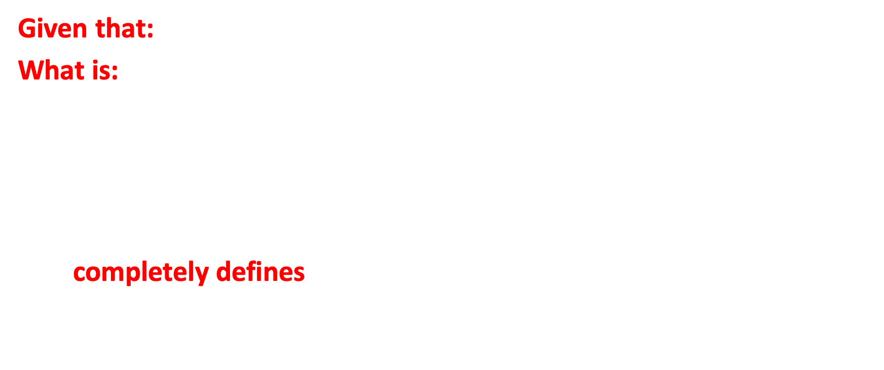
C: continue
Given that: a user is looking at the document at rank $i$
What is: the probability that they will continue, and look at the document at rank $i+1$?
$C_{i}=Pr(\text{continue} \text{to} i+1 | \text{looking} \text{at} i)$
This completely defines a metric!
Notes:
Need to pause and dwell on conditional probabilities.
If I roll a dice and tell you that it was an even number, what is the conditional probability that it is a four? A five?

Slide 17
C: continue
Precision at k=5
RBP, φ=0.6
Notes:
Static models/metrics say the user’s behaviour doesn’t depend on the SERP

Slide 18
C: continue
Reciprocal rank
INST, T=1
Relevant result at rank 3
Relevant result at rank 3
Notes:
Gain-sensitive models/metrics depend on where the relevance is

Slide 19

C: continue
And another one:
$C_{i}=$ $\frac{\sum_{j=i+1}{ (r_{j}/j)}}{\sum_{j=i}{ ({r_{j}}/j)}}$
Any guesses as to which metric assumes that the user already knows where the relevant documents are??

Slide 20


W: weight
$$W_{i}=\frac{\prod_{j=1}^{i−1}{C_{j}}}{\sum_{k}{\prod_{j=1}^{k−1}{C_{j}}}}$$
If the conditional continuation probability is given by $C_{i}$ then $W_{i}$ is the fraction of total user attention spent on the document at rank $i$.
Notes:
C completely defines a metric
AS AN ASIDE we can show this with the W part of C/W/L
…familiar discount curves etc…

Slide 21
W: weight
Precision at k=5
RBP, φ=0.6

Slide 22
W: weight
∑
×
weights
gains
= Expected gain per document examination
Bad
Bad
Good
Fair
Good
Notes:
and W.r is the "usual" metric
NB units: we can talk about E(gain per inspection) BUT ALSO total gain, etc etc - NB we need to be consistent in naming here
can even include costs explicitly (not as #docs), e.g. TBG, Bejeezus?, IFT, ...

Slide 23
W: weight
W ∙ r
= Expected rate of gain
Where both W and r are real-valued vectors.
Notes:
Both W and r can be thought of as vectors of values

Slide 24
Precision at k=5
RBP, φ=0.6
W = (.2, .2, .2, .2, .2, 0, …)
r = (0, 0, 1, 1, 1, 0, …)
W.r = 0 + 0 + .2 + .2 + .2 + 0 + 0…
W.r = .6, with no uncertainty
W = (.4, .24, .14, .09, .05, .03, …)
r = (0, 0, 1, 1, 1, 0, …)
W.r = 0 + 0 + .14 + .09 + .05 + 0…
W.r = .28, and residual .08
Notes:
It really works! C → W, then the inner product of W and r is the metric – for lots and lots of metrics we use in IR eval

Slide 25
RR
INST, T=1
W = (.33, .33, .33, 0, 0, 0, …)
r = (0, 0, 1, 1, 1, 0, …)
W.r = 0 + 0 + .33 + 0 + 0 + 0…
W.r = .33, with no uncertainty
W = (.47, .21, .12, .07, .04, .02, …)
r = (0, 0, 1, 1, 1, 0, …)
W.r = 0 + 0 + .12 + .07 + .04 + 0…
W.r = .22, and residual .05

Slide 26
Knowing the unknown
The residual is an indication of how much of the score volume is not covered by relevance judgements.
For C/W/L metrics, it is easy to compute:
first assume that every unjudged document is non-relevant, and compute a lower-bound metric value;
then assume that that every unjudged document is fully relevant, and compute an upper-bound metric value.
If the range between them is non-trivial, then need to be careful.

Slide 27


L: last view
$$L_{i}=\left(\prod_{j=1}^{i−1}{C_{j} }\right)\left(1−C_{i}\right)$$
If the conditional continuation probability is given by $C_{i}$ then $L_{i}$ is the fraction of users who last look at the document at rank $i$.
Notes:
Continue past everything earlier; then stop
NB this turns out to be a probability distribution…!

Slide 28
L: last view
Precision at k=5
RBP, φ=0.6

Slide 29

ERG versus ETG metrics
$$\sum_{i}{\left(L_{i}\sum_{j=1}^{i}{r_{j}}\right)}$$
= Expected total gain
ERG metrics have units of “rels per document”.
ETG metrics have units of “rels”.
Notes:
Then we can talk about the total gain over the whole SERP

Slide 30


ERG versus ETG metrics
$$\sum_{i}{i .L_{i}}$$
= $\frac{1}{W_{1}}$ = Expected depth
For any C/W/L metric, ETG = ERG/$W_{1}$
Notes:
The ERG and ETG forms of a metric are directly connected, there is no escape from the math relationship

Slide 31
C/W/L spells “cool”…
C
Continue
W
Weight
L
Last
Notes:
C completely defines a metric
So does L.
So does W.
And each of then can be computed from either of the other two.

Slide 32
What does it cost to look at a document?
Suppose that $k_{i}$ is the cost of examining the document at rank $i$.
W∙k
= Expected rate of cost
With units of seconds per document, or $ per document.
Notes:
If we have a cost vector k we can also talk about cost/document, expected total cost

Slide 33


What does it cost to look at a document?
$$\sum_{i}{\left(L_{i}\sum_{j=1}^{i}{k_{j}}\right)}$$
= Expected total cost
With units of seconds, or $.
And ETC = ERC/$W_{1}$.

Slide 34
Properties of models: Desiderata
Notes:
NB for all of these we should tie back to LA/GZ's slides: here are some things they've discussed earlier, and we can turn them into constraints on the shape of C

Slide 35
C/W/L spells “cool”…
C
W
L
Now what?
Can we think about C/W/L functions that somehow or another “make sense”?
Can we find C/W/L functions that match observable user behavior?
Notes:
We now have three interlocking functions, any of which can be used to define a metric.
Can start with W, the traditional approach, or can start with C, or can start with L.

Slide 36
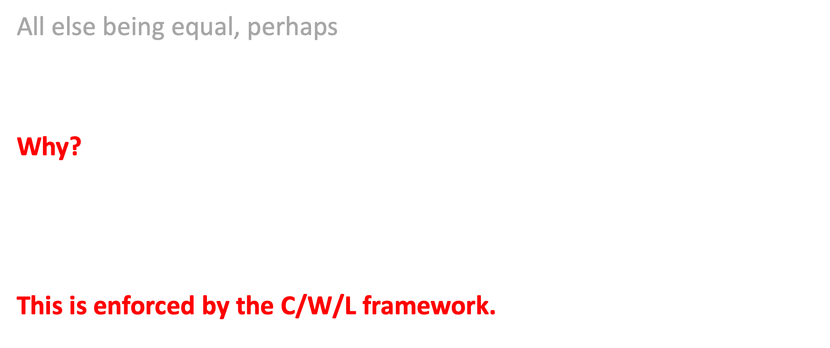
Top-weighted
All else being equal, perhaps
$W_{i}$ should decrease (or stay the same) with depth $i$.
Why?
Searchers pay more attention to things at the top.
This is enforced by the C/W/L framework.

Slide 37
What does the (click) data say?
Click-throughs covering a total of 34 users, 6 topics per user. Each SERP showed 10 snippets, with 7 visible in initial screen.
Thomas et al, AIRS 2013

Slide 38
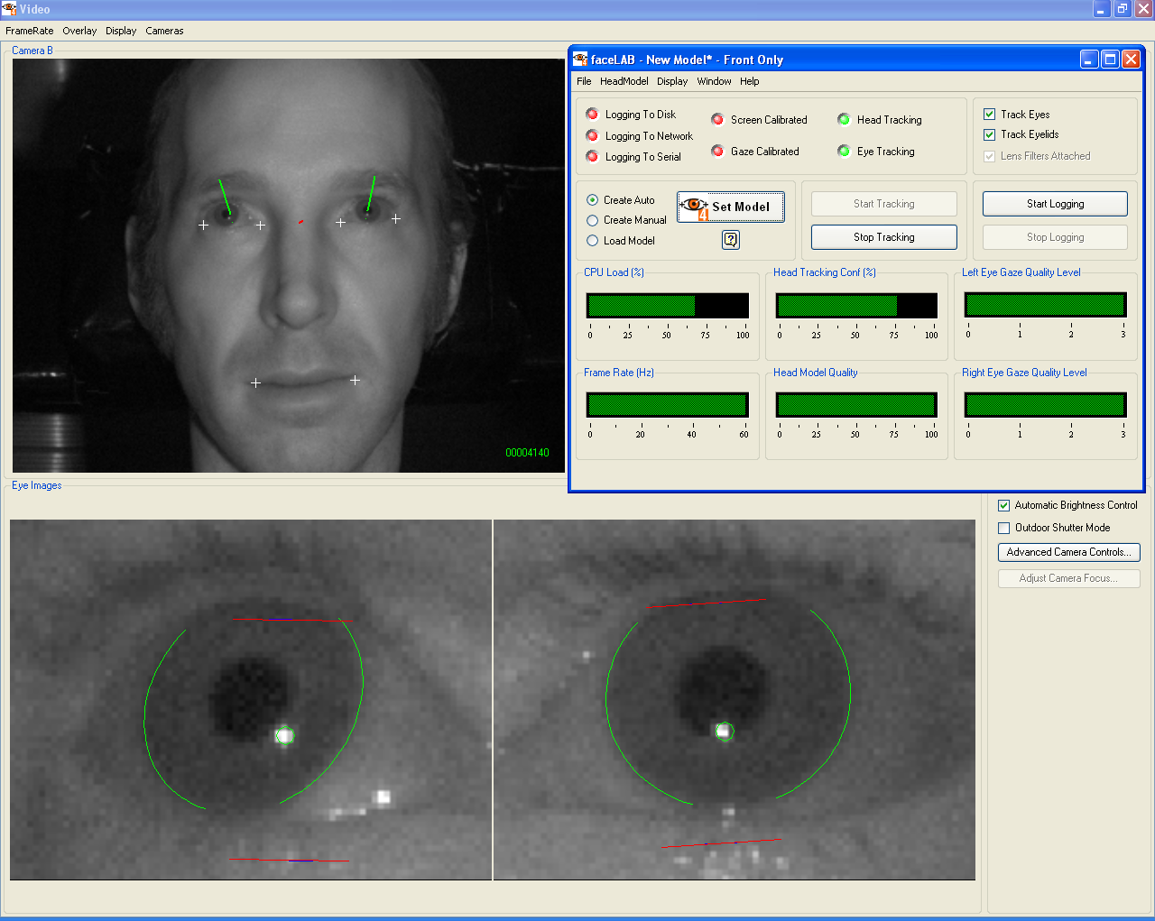
What does the (gaze) data say?
Watching the watchers…

Slide 39
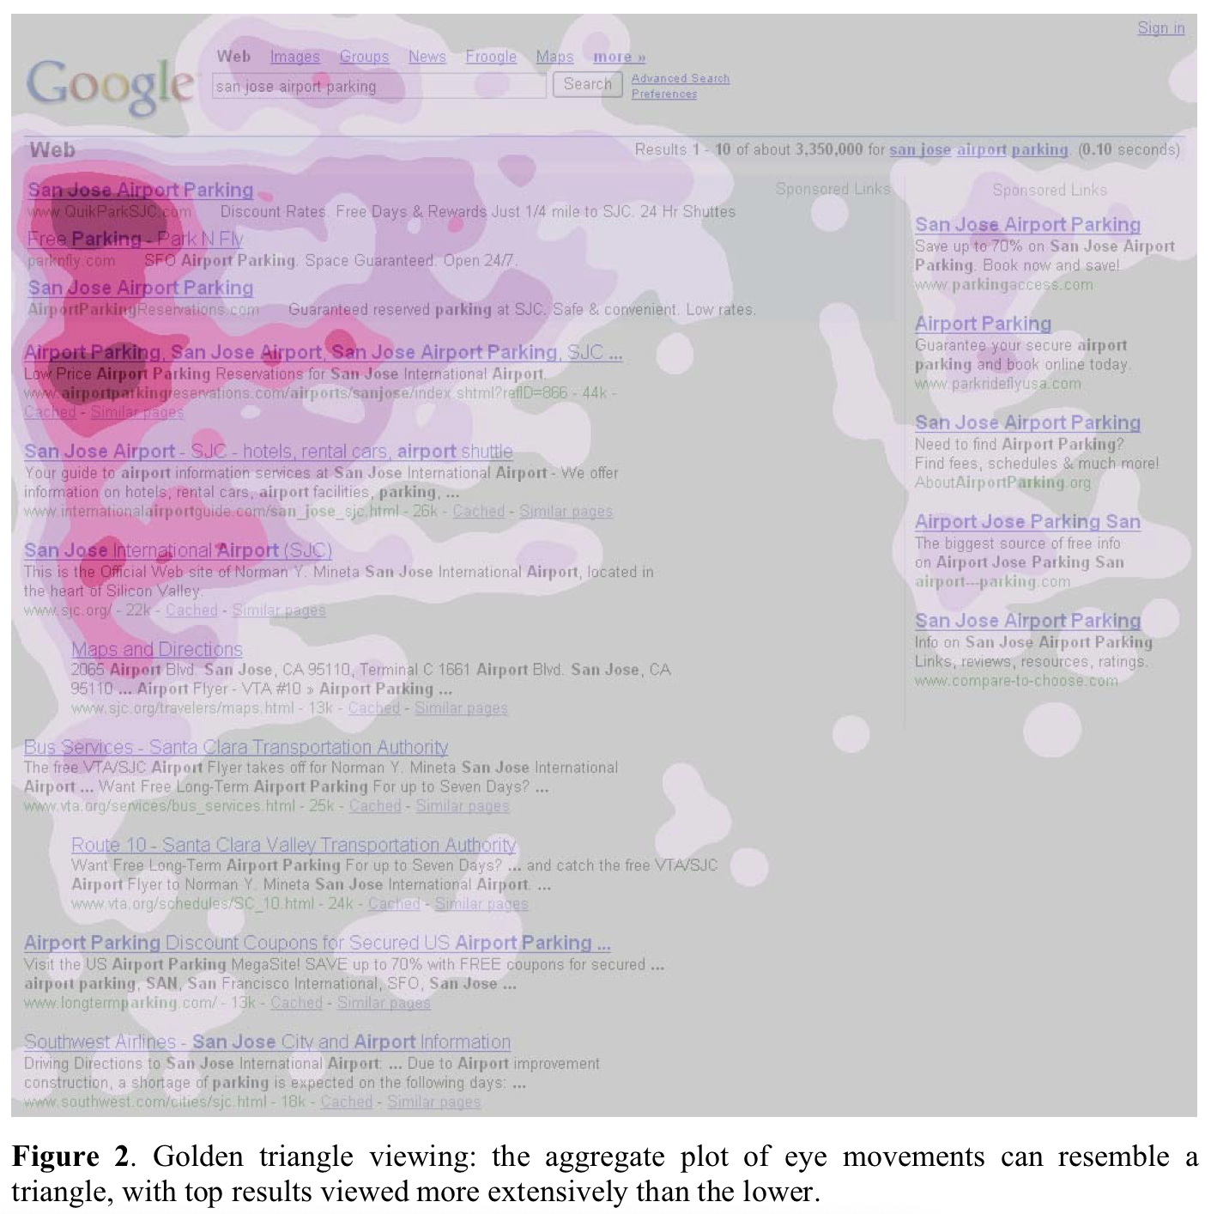
What does the (gaze) data say?
The “golden triangle” of viewing area for text presentation.
(Or, the “focused F”.)
Granka et al, 2008

Slide 40
What does the (gaze) data say?
Gaze fixations covering a total of 34 users, 6 topics per user. Each SERP showed 10 snippets, with 7 visible in initial screen.
Thomas et al, AIRS 2013

Slide 41
What does the (gaze) data say?
Gaze fixation jumps covering a total of 34 users, 6 topics per user. Each SERP showed 10 snippets, with 7 visible in initial screen.
Thomas et al, AIRS 2013

Slide 42
What does the (inferred viewing) data say?
Job search, 32,000 SERPS via iOS/ Android apps, October 2017 to April 2018
Wicaksono and Moffat, CIKM 2018

Slide 43
Just a thought on the side…
Maybe the fact that users focus on the top positions in the SERP is a consequence of them trusting the ranking system to put the best answers there? (Anyway, does it matter?)
If there are image or video elements on the SERP, they tend to attract the eye and disrupt the overall top-down pattern.

Slide 44
Paul said: MSFT paper on trust/rank bias

Slide 45
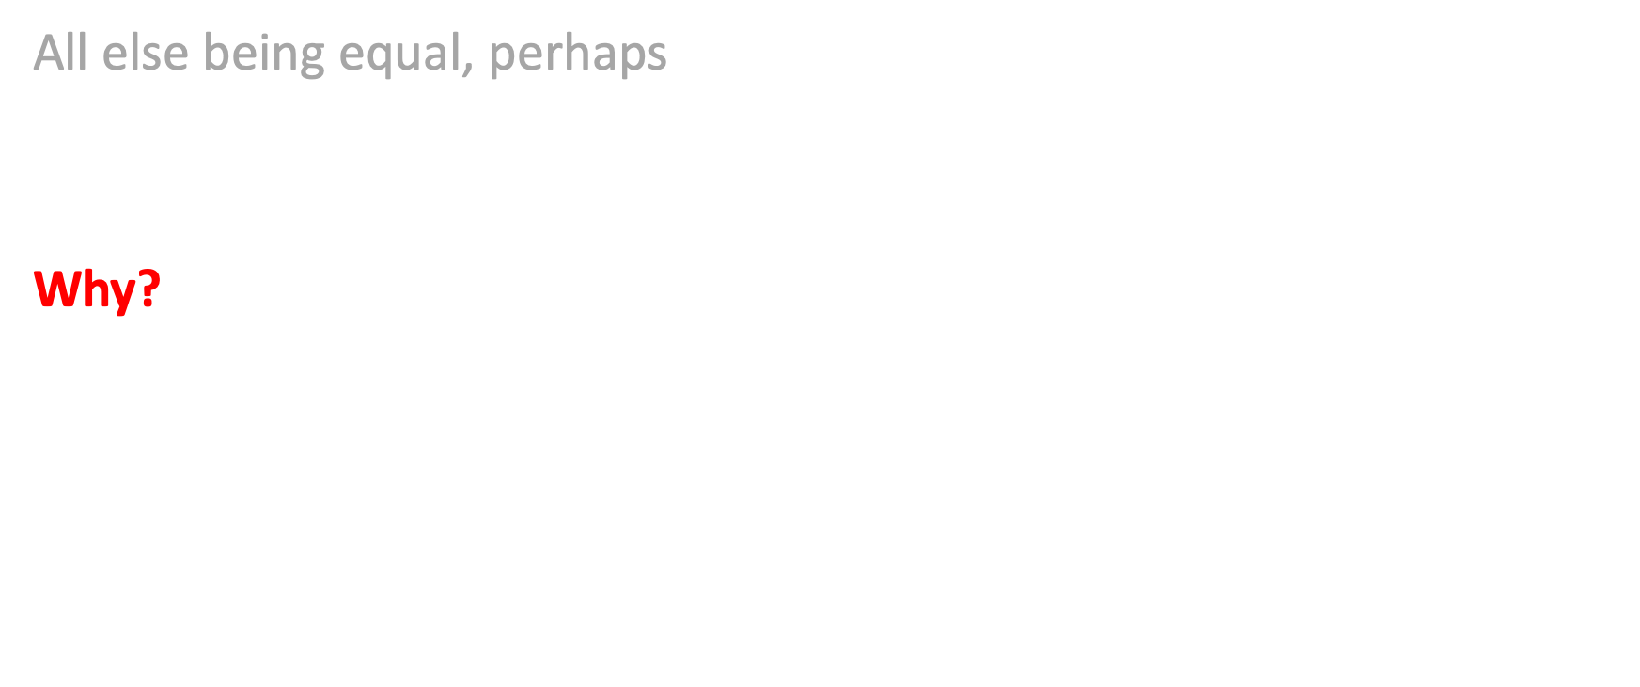
Non-decreasing
All else being equal, perhaps
$C_{i}$ should increase (or stay the same) with depth $i$.
Why?
Because we have more and more evidence that for this user and this search there will be many results examined.

Slide 46
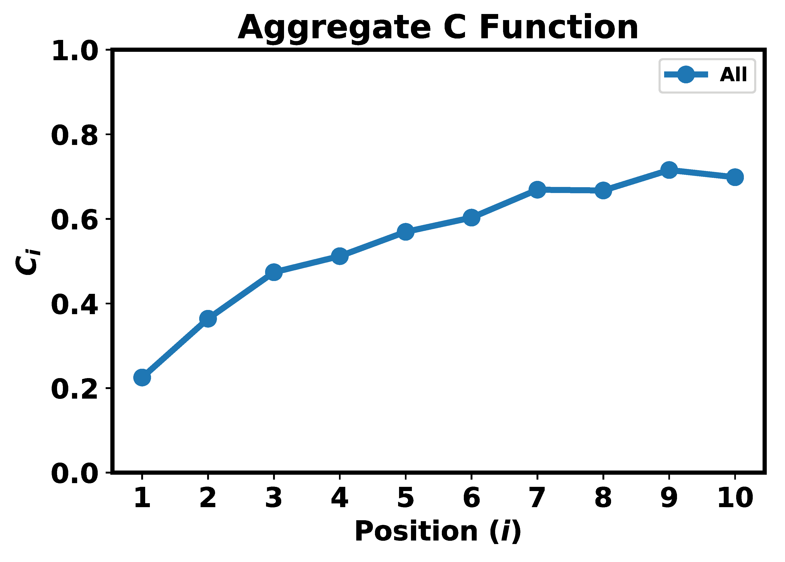

What does the (interpolated click) data say?
Bing data, US English, 16.4M queries over two weeks.
(Microsoft unpublished)
Notes:
Just MLE – the proportion of people observed stopping past this rank
16.4M query impressions on Bing, US English, two weeks
(Although NB we made some strong assumptions about reading order, when there are two columns)

Slide 47
What does the (inferred viewing) data say?
Job search, 32,000 SERPS via iOS/ Android apps, October 2017 to April 2018, infinite scroll.
Wicaksono and Moffat, CIKM 2018

Slide 48
What does the (inferred viewing) data say?
Job search, 22,000 SERPS via computer browser, October 2017 to April 2018, 20 items per page.
Wicaksono and Moffat, CIKM 2018

Slide 49
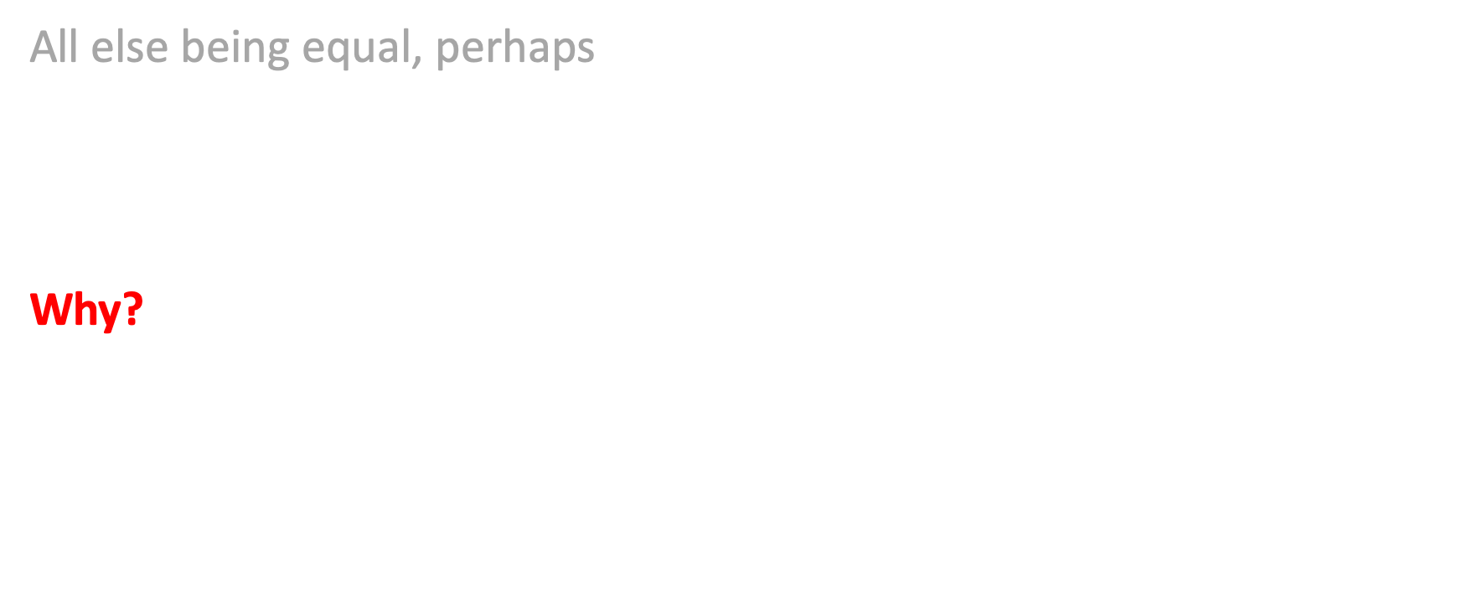
Goal-sensitive
All else being equal, perhaps
$C_{i}$ should be higher if we are looking for more stuff, quantified by variable $T.$
Why?
Because it takes longer to find more.

Slide 50
What does the data say?
Estimated number of useful documents that will required for three different types of task, totaling 8,000 responses from 98 crowd workers, reading 180 topic backstories.
Bailey et al, SIGIR 2015
Notes:
When given backstories that lead to straightforward information needs, users tend to require only a small volume of relevance.
For complex information needs, they may seek out many useful documents, including ones with contrasting view.

Slide 51
What does the data say?
Estimated number of queries predicted to be required to identify that number of useful documents.
Bailey et al, SIGIR 2015
Notes:
That seeking out might also include a quite deliberate intention to execute multiple queries.

Slide 52
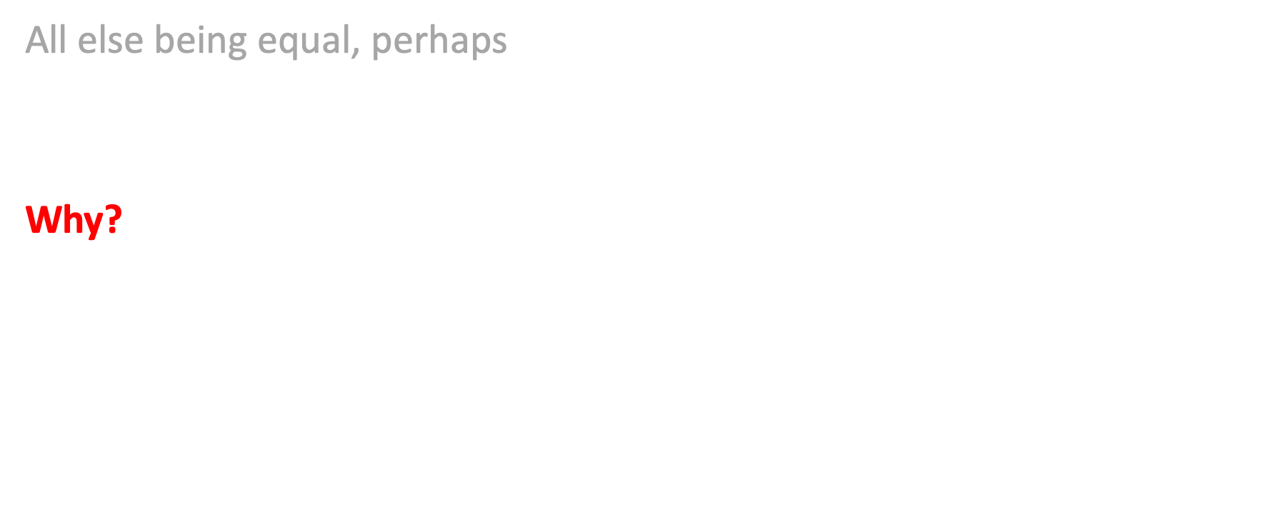
Gain-sensitive
All else being equal, perhaps
$C_{i}$ should decrease as gain is accrued.
Why?
Because we are likely to be less persistent as we approach (and then go past) our initial goal.

Slide 53
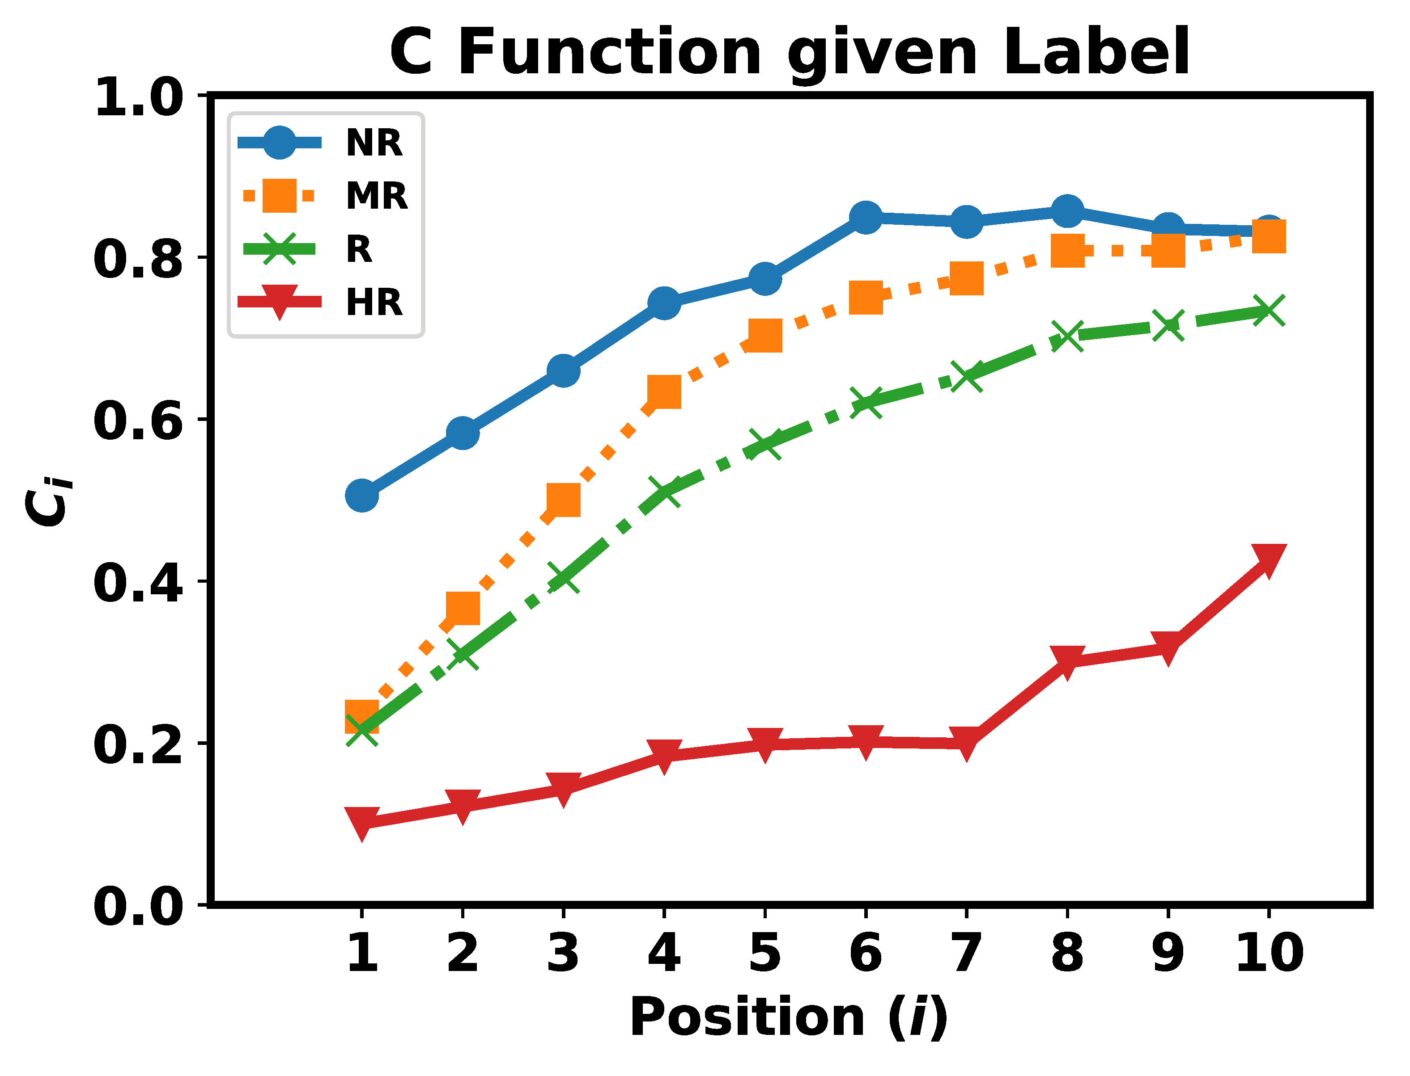
What does the (interpolated click) data say?
Observed probability of continuing after encountering different grades of relevance. Bing data, US English, 16.4M queries over two weeks.
(Microsoft unpublished)
Notes:
Not Rel, Marginally Rel, Rel, Highly Rel (at i alone)
Note that getting more relevance always reduces C

Slide 54
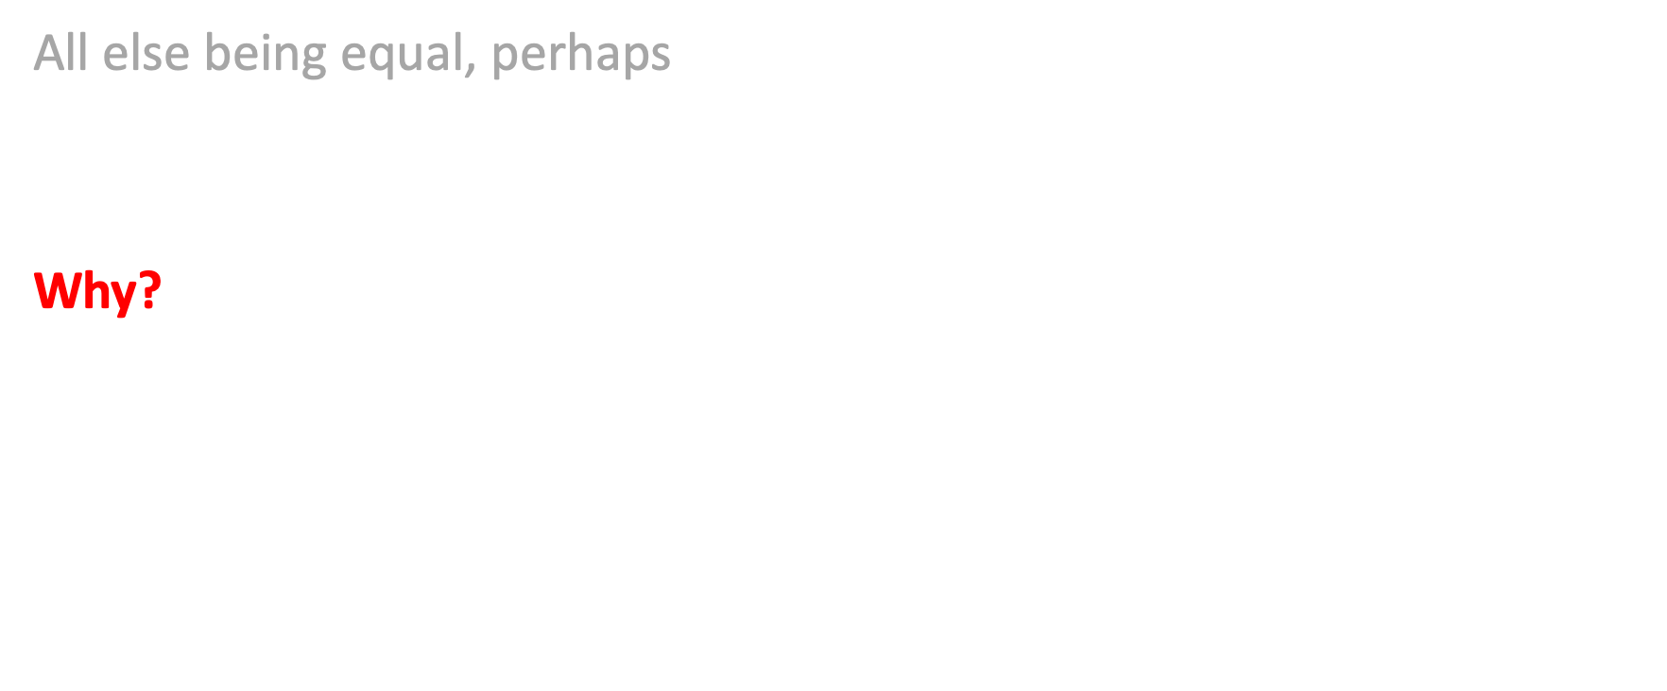
Rate-sensitive
All else being equal, perhaps
$C_{i}$ should be positively influenced by the current average rate of gain.
Why?
We’ll persist while we’re getting stuff easily; we’ll make hay while the sun shines; we’ll pluck the low-hanging fruit; we’ll keep going while the going is good; strike while the iron is hot. And we’ll get annoyed by rubbish.

Slide 55
What does the (????) data say?
[Watch this space]
Notes:
Point at the IFT paper: if put in the metric, the metric looks better, but not hard evidence.

Slide 56
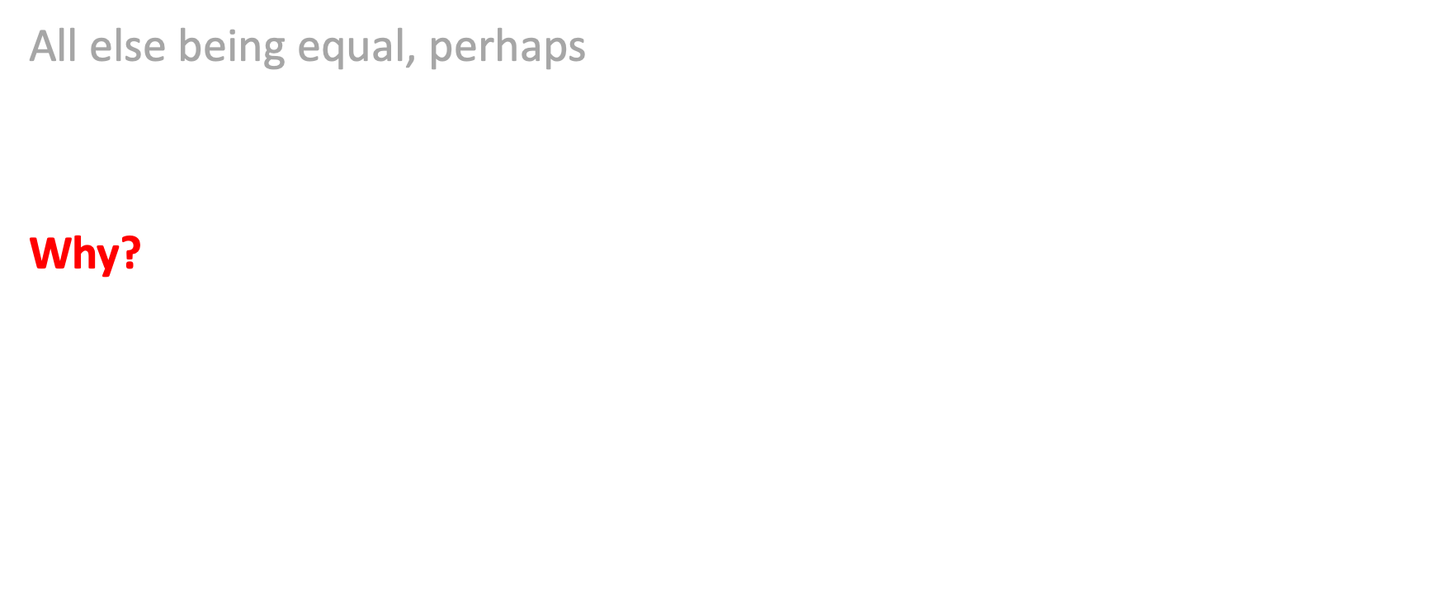
Cost-sensitive
All else being equal, perhaps
$C_{i}$ should decrease if accessing the documents is costly (seconds or $).
Why?
We are likely to be less persistent as we take longer, and more encouraged to consider alternative tools if it costs more.

Slide 57
What does the (????) data say?
[Watch this space]

Slide 58
What does the (overall) data say?
Top-weighted Forced by C/W/L
Non-decreasing We have some evidence
Goal-sensitive We have some evidence
Gain-sensitive We have some evidence
Rate-sensitive We have weak evidence (plus a strong hunch)
Cost-sensitive We have weak evidence (plus a strong hunch)

Slide 59
Can we have all the desired things?
 | P | SDCG | RR | RBP | AP | …?... | INST | IFT
Top-weighted | ✔ | ✔ | ✔ | ✔ | ✔ |  | ✔ | ✔
Non-decreasing | ❌ |  | ❌ | ✔ |  |  | ✔ | ✔
Goal-sensitive | ❌ | ❌ | ❌ | ❌ |  |  | ✔ | ✔
Gain-sensitive | ❌ | ❌ | ✔ | ❌ |  |  | ✔ | ✔
Rate-sensitive | ❌ | ❌ | ❌ | ❌ | ❌ |  |  | ✔
Cost-sensitive
Notes:
Yellow X and smilie mean “kind of, there could be an argument made”.
So scale = red X mans really definitely no, then yellow X means not really, then yellow smile means yeah, kind of, then green smilie means “yes, definitely fits”.

Slide 60
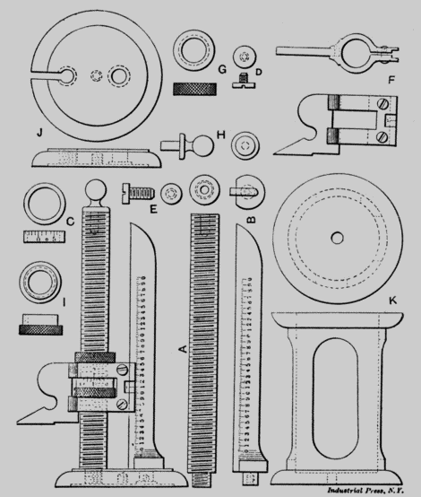
Measuring the measures
Qui judicas judices?
Notes:
So now we’ve got a bunch of models defining a bunch of measures or metrics
All in the same framework, all with coherent units.
But so what? How do we choose? What makes a metric “better”?

Slide 61
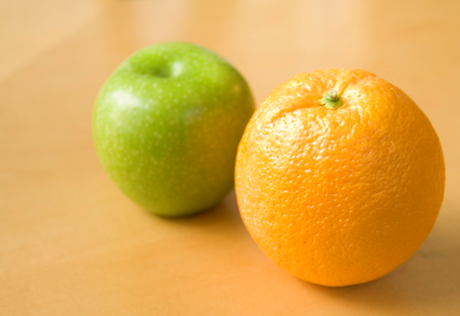
Measuring the measures
Notes:
So now we’ve got a bunch of models defining a bunch of measures or metrics
All in the same framework, all with coherent units.
But so what? How do we choose? What makes a metric “better”?

Slide 62
Can we show that one model (or its equivalent metric) is better/worse than another? Can we do experiments that compare metrics? Or, are we doomed to rhetorical arguments?? (At the same time admitting that arguments in which you can’t google the answer are much more fun than ones where you can!)
Can metrics be measured?

Slide 63
If a user model is an attempt to predict users’ collective behavior, can we observe those behaviors and correlate back to metrics? Or are the hairs that the models are splitting too fine to be distinguished via observation?
Can models be measured?

Slide 64

Many connections…
Outcome
Behavior
Score
Metric
User Model
Score
Metric
User Model
Scores
Metrics
User Models
Notes:
LHS:
1. User issues query to obtain an outcome, and is hoping to be satisfied
2. To represent the quality of that outcome, we want to identify a numeric score that correlates with satisfaction.
3. To compute that score, we employ the notion of a metric.
4. But hey, gee, a metric corresponds to a user model.
5. And that user model predicts some behavior.
6. And we also have the option of correlating that behavior with the original outcome that was inferred.
7, 8. But there are many options of metric – and hence, many scores and many user models -- which one should we use?
9. Look at where the correlations fall, can test outcome/satisfaction versus score
10. And can test behavior versus predicted behavior from user model.
Both of those latter two routes provide a way of deciding the applicability of a metric.
It will depend heavily on the type of task and the user’s goals.

Slide 65
(this is Alfan/Alistair, Leif/Paul/Nick for example; also Emine/Nick and doubtless others)
rhetoric
theory
alignment with observations of behaviour
other nice properties e.g. sensitivity, simplicity, ...
how complex do we need to be in our models?

Slide 66
Property
Behaviour
Value
Value judgement
Online
Offline
Notes:
A bit more concrete
A not-very-grand unified theory of searcher models for IR evaluation
Online metrics: observe behaviour and use this to predict some aspect, or property, of the SERP or the session or the item; e.g. click predicts relevance, quick back predicts non-relevance, requery predicts poor SERP
Offline: use some aspect, or property, to predict behaviour; e.g. click models

Slide 67
Property
Behaviour
Value
Value judgement
Value judgement
Online
Offline
Notes:
Then there’s another part: we assign value to these behaviours+properties; e.g. we say that a (SAT) click is good, and two clicks are twice as good; or a click on spam is bad; or more time on the SERP is bad; or etc

Slide 68
Property
Predicted behaviour
Metric
Value judgement
Online
User model
Notes:
But in practice these are instincts, or if you prefer they are matters of policy
So this is what we have for analysis: the user model is the thing that links the two
For offline metrics it’s the thing that tells us, given a SERP with some properties – or a list of things each with some properties – what we think a searcher will do
And the metric is the thing that gives you a number saying how well you’ve done
In practice the value judgements are pretty much the same: accumulating relevant information is good, simple as that
So what’s different from one metric to the next is the user model

Slide 69
How to compare?
Satisfaction?
Observable behaviour!
Notes:
Sensitivity
Cost to compute…
But: validity, predicting something in the real world

Slide 70

Possible observations
Gaze impressions, either by eye-tracking or by inference from other behavior, connected to $W_{i}.$
Continuations, $C_{i},$ derived from gaze impressions or other behavior.
User “last document viewed” behavior, connected to $L_{i}$.
User click-throughs, as an indicator of relevance (or maybe of non-relevance!), $r_{i}$. Use with care!
User (non-)reformulation rates, as an indicator of outcome/satisfaction?
Conversion rates (e-commerce), sales, net revenue.
Notes:
Plus plenty of more far-fetched ones, including chair wriggling, mouse hovers, verbalisations,…

Slide 71

Impressions
In some applications, impression sequences might be known from log data, or via explicit gaze tracking:
<1, 2, 3, 2, 4, 5, 3, 6, 5, 6, 7, 8, 7>
From these, can seek to infer values for $C_{i}$ and/or $W_{i}$.
Can then compare the inferred values with values predicted by metrics.
Notes:
Red is a click, trying to show typical user behavior.

Slide 72
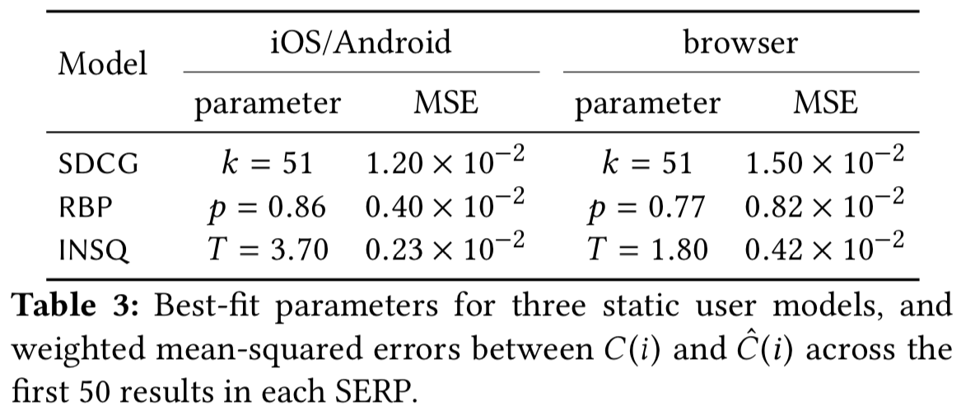



Impressions
Wicaksono and Moffat, CIKM 2018

Slide 73
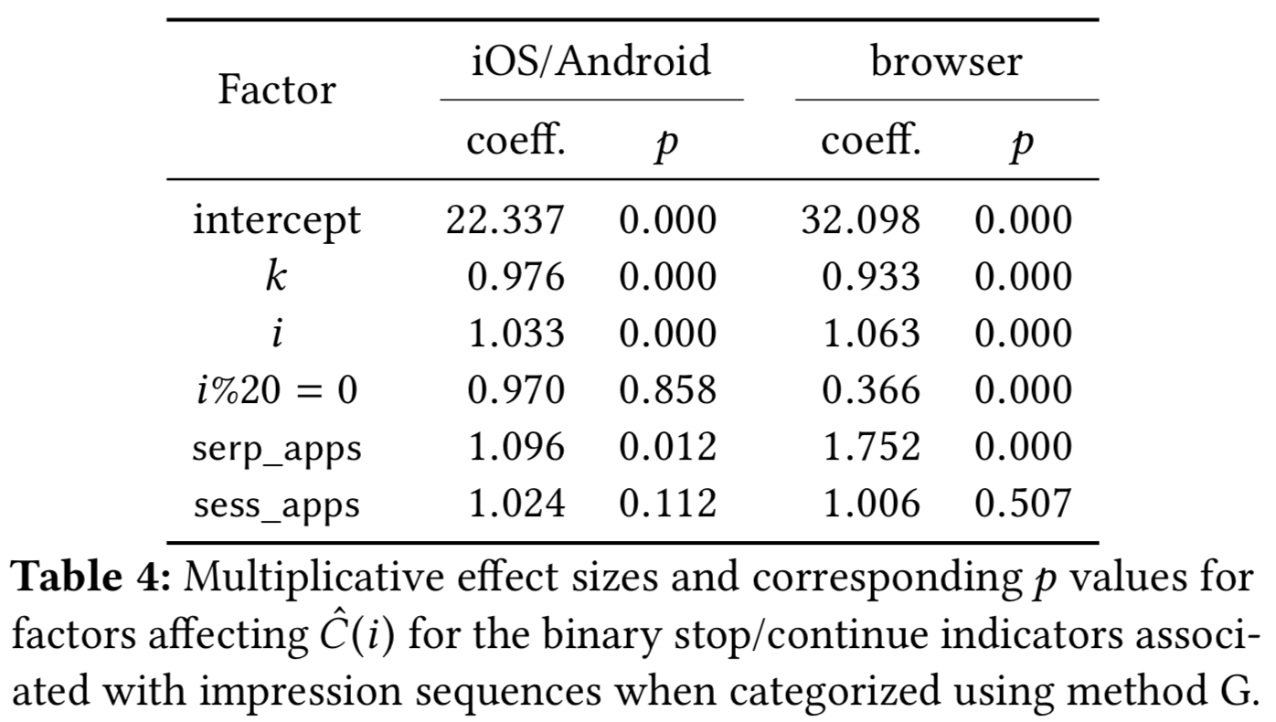









Impressions
Wicaksono and Moffat, CIKM 2018

Slide 74
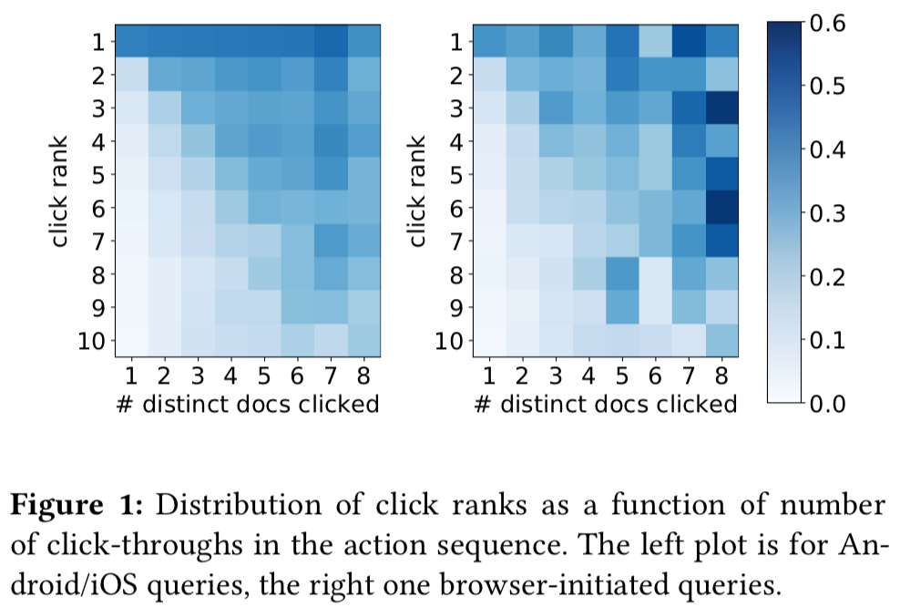
Clicks (maybe??)
Wicaksono and Moffat, ADCS 2018

Slide 75
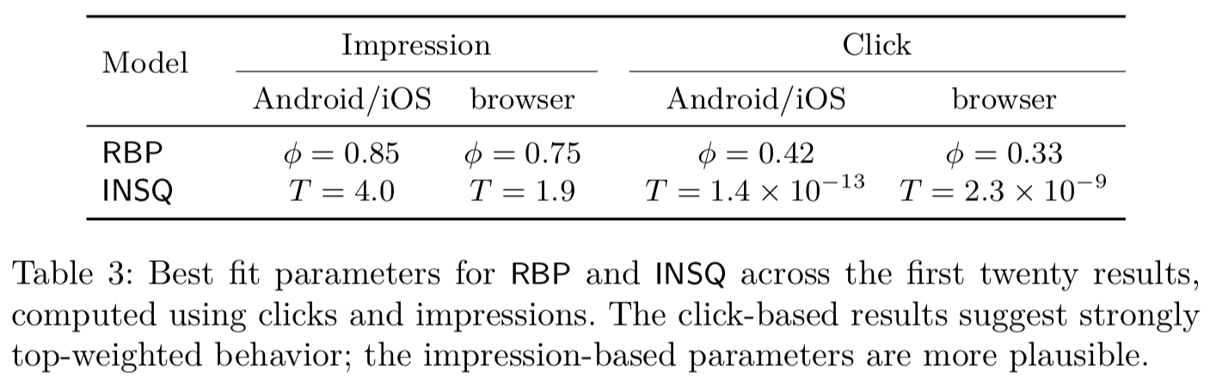




Clicks (maybe not??)
Wicaksono et al, ECIR 2019

Slide 76
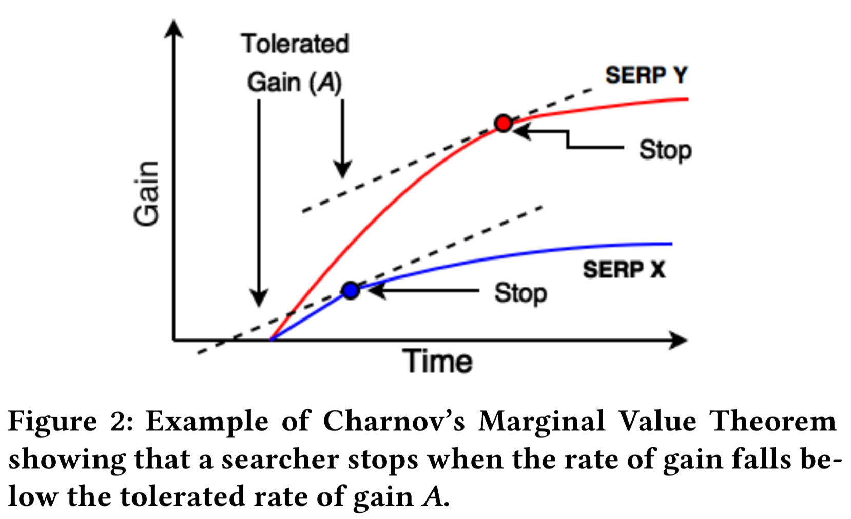
Another idea – Information foraging
Azzopardi et al, SIGIR 2018

Slide 77
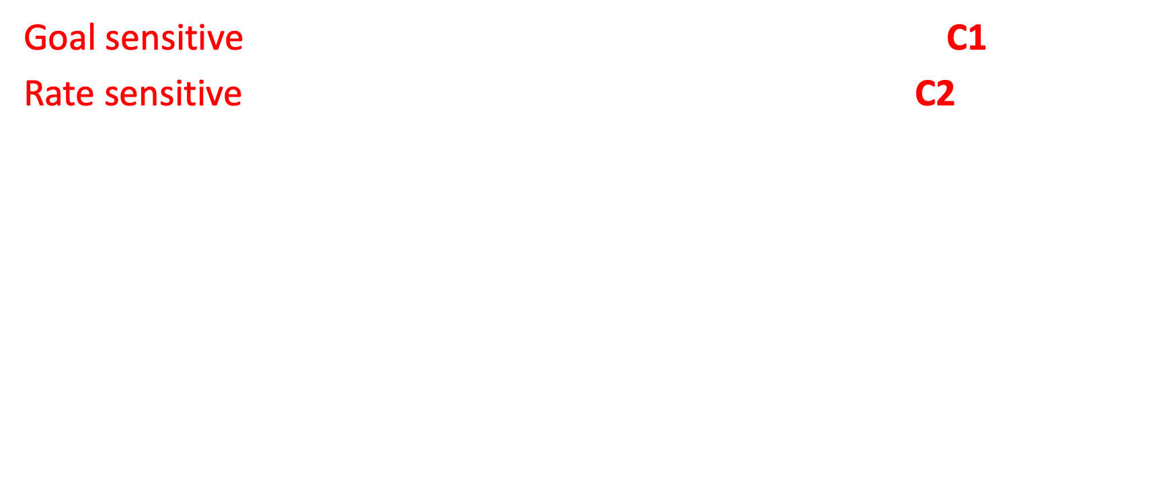
Combine these competing factors
Goal sensitive: stop when required gain (T) has been met. C1
Rate sensitive: stop when the rate of gain (A) is too low. C2
$$C_{i}={C1}_{i} ∗C2_{i}$$
Azzopardi et al, SIGIR 2018
Notes:
We will define a C
C1…
C2…
Assume independence, C=C1*C2

Slide 78

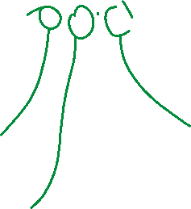

C1 and C2
$${C1}_{i}=1−{\left(1+b_{1}×e^{\left(T−γ_{i}\right)R_{1}}\right)}^{−1}$$
searcher’s target
rationality
Goal sensitivity
1
gain so far
C1
0
Azzopardi et al, SIGIR 2018
T
Gain so far, $γ_{i}$
Notes:
C1 is goal sensitivity – have we found enough, is our tummy full?
Scary but simple really: sigmoid. T is target, gamma is gain to date, so T-gamma is remaining appetite
R is rationality, how much impact goal has.
The sigmoid function encodes our uncertainty – and our imperfect information / knowledge
Examples: R=inf perfectly rational, stop iff we’ve got enough, R=0 agnostic, R=in between

Slide 79


C1 and C2
$${C1}_{i}=1−{\left(1+b_{1}×{ e}^{\left(T−γ_{i}\right)R_{1}}\right)}^{−1}$$
$${C2}_{i}={\left(1+b_{2}× e^{\left(A−{γ_{i}}/{κ_{i}}\right)R_{2}}\right)}^{−1}$$
Goal sensitivity
Rate sensitivity
1
1
C1
C2
0
0
T
Gain so far, $γ_{i}$
A
Rate of gain so far, ${γ_{i}}/{κ_{i}}$

Slide 80
Bing log data
One thousand popular queries at Bing from desktop computers.
Gain estimated from average of 12.8 response elements per SERP, over 670,000 query impressions.
Judgments then collected for the 12,800 unique elements, so that gain for each SERP was computable.
For each query impression, gain then estimated as a function of the elements clicked.

Slide 81

Observable behaviour (1)
Stopping
Accumulated utility
Accumulated cost
$$\text{Likelihood} \text{of} \text{stopping} \text{at} i$$
$$=L_{i}$$

Slide 82
Model / measure | Mean likelihood
P@1 | 0.49
P@5 | 0.00
P@10 | 0.00
SDCG@1 | 0.49
SDCG@5 | 0.33
SDCG@10 | 0.33
RR | 0.36
RBP, φ=0.1 | 0.44
RBP, φ=0.7 | 0.16
INST, T=1 | 0.34
INST, T=2 | 0.21
IFT | 0.76
Azzopardi et al, SIGIR 2018
Notes:
Both tuned and commonly used
Shallow – more likely
But not always best, e.g. P@1 is .49 so 1/2 the time people stop lower

Slide 83

Observable behaviour (2)
Stopping
Accumulated utility
Accumulated cost
$$\text{Expected} \text{total} \text{utility}=\sum_{i}{\left(L_{i}\sum_{j=1}^{i}{r_{i}}\right)}$$
Notes:
Look at …… impressions, look at clicked results and relevance labels for these, add up over a session
Report MAE

Slide 84
Model / measure | MAE (utility)
P@1 | 0.32
P@5 | 0.47
P@10 | 0.65
SDCG@1 | 0.32
SDCG@5 | 0.26
SDCG@10 | 0.38
RR | 0.36
RBP, φ=0.1 | 0.32
RBP, φ=0.7 | 0.38
INST, T=1 | 0.34
INST, T=2 | 0.36
IFT | 0.16
Azzopardi et al, SIGIR 2018

Slide 85
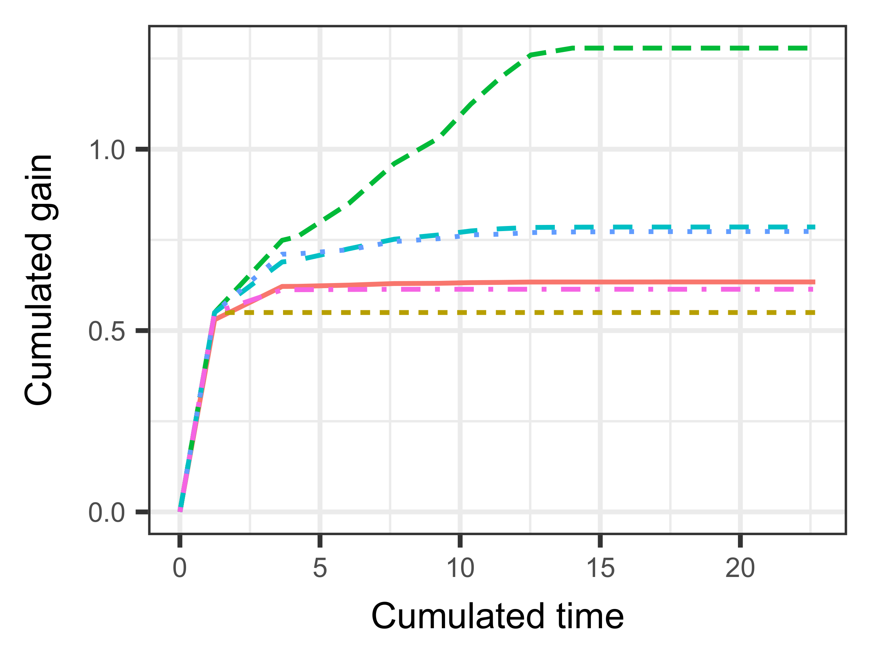
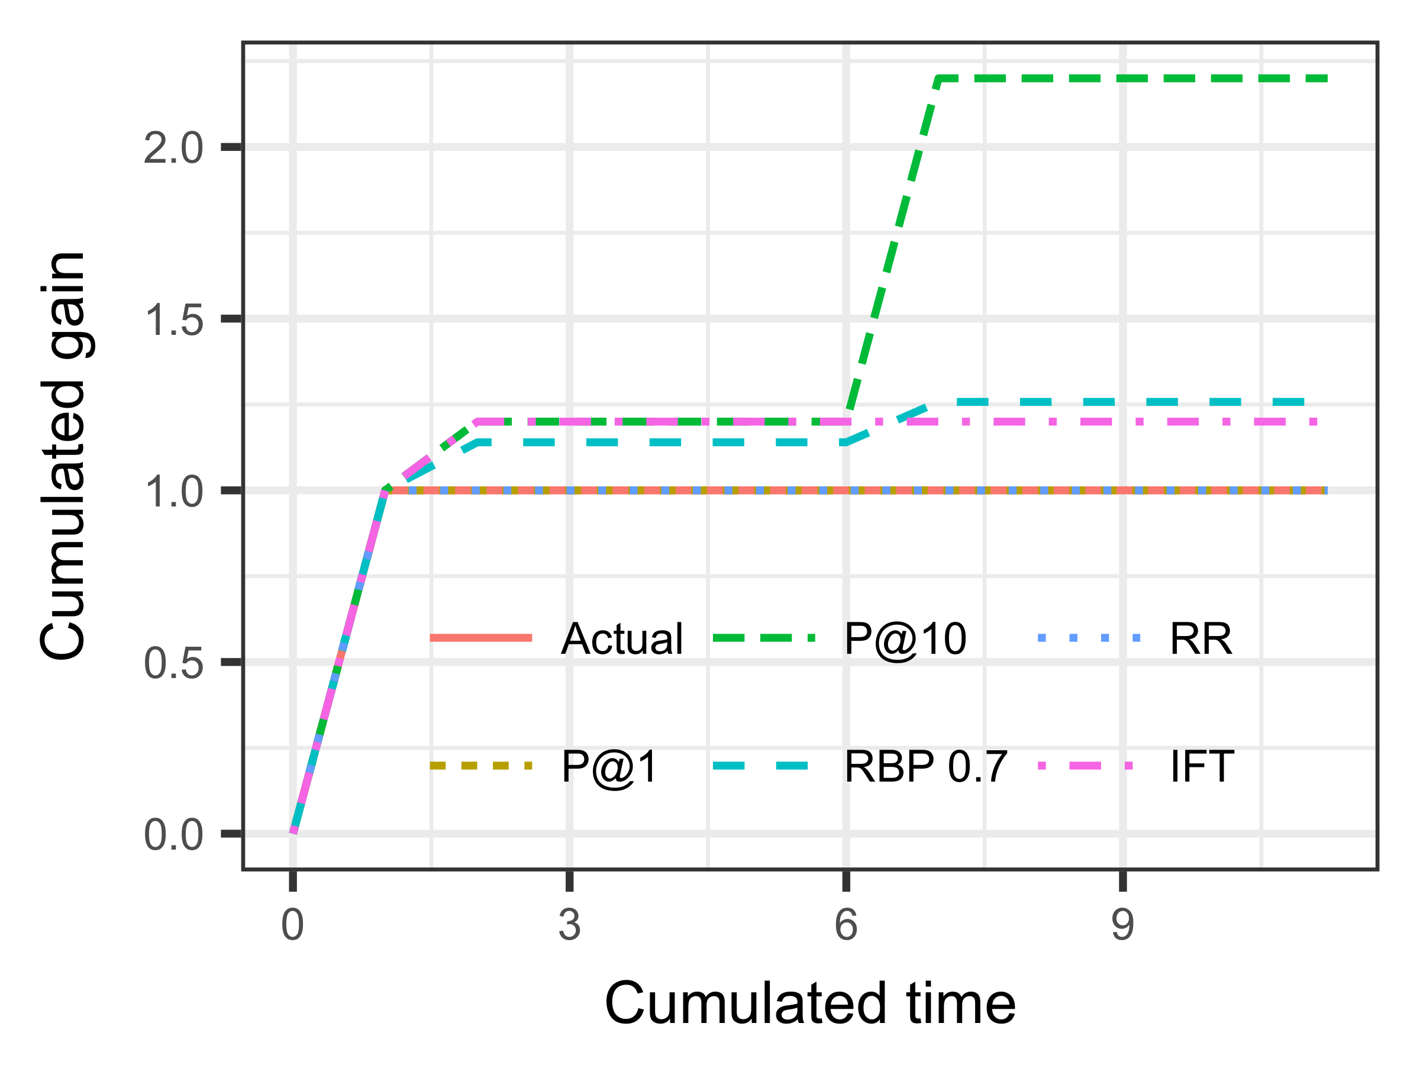


P@10 way too high
RBP, RR both too high
IFT does well
P@1 a bit low
Average toral gain over 5000 impressions
Notes:
Average over 5000 impressions, starting to look good

Slide 86

Observable behaviour (3)
Stopping
Accumulated utility
Accumulated cost
$$\text{Expected} \text{total} \text{cost}=\sum_{i}{\left(L_{i}\sum_{j=1}^{i}{k_{i}}\right)}$$

Slide 87
Model / measure | MAE (cost)
P@1 | 0.91
P@5 | 4.31
P@10 | 7.73
SDCG@1 | 0.91
SDCG@5 | 3.10
SDCG@10 | 4.98
RR | 1.71
RBP, φ=0.1 | 1.03
RBP, φ=0.7 | 2.60
INST, T=1 | 1.44
INST, T=2 | 2.16
IFT | 0.63
Azzopardi et al, SIGIR 2018

Slide 88
But what about outcomes/satisfaction?
Laboratory/user studies can evaluate satisfaction via a range of mechanisms, including direct survey of users after task completion
In the end, the fundamental goal is to efficiently support task completion.
An effective system might be measured by the time it takes to accomplish the task. But the pleasure derived while carrying out the task is also a factor that will affect user return rate.
Commercially, the long-range goal is to maximize shareholder value.

Slide 89
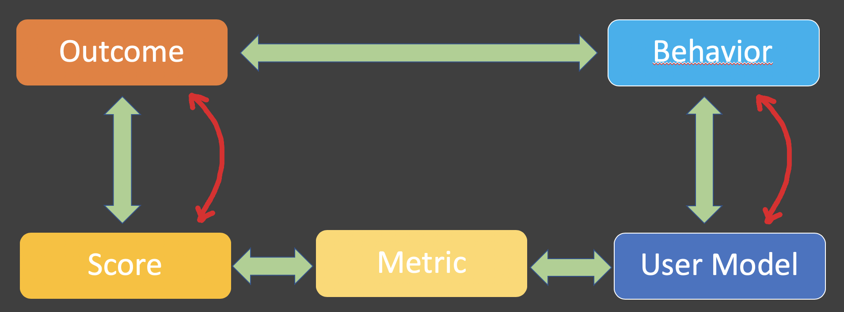
If satisfaction has been measured…
Look for correlations between outcome and score.
Then compare those correlations with the ones that arise between behavior and predicted behavior.
Hope they favor the same metrics for each application!

Slide 90

Anything left to be said? Only one thing…
$$C_{i}=0 !$$
Get it??

Slide 91
But just in case you ask…

Slide 92


Definitions of metrics – Precision at $k$
If $i<k$, then $C_{i}=1$.
If $i≥k$, then $C_{i}=0$.

Slide 93

Definitions of metrics – Reciprocal rank
$$C_{i}= \left\{\begin{matrix}1, \text{i}\text{f} r_{i}<1 \\ 0, \text{otherwise} \end{matrix}\right\}$$

Slide 94


Definitions of metrics – Rank-biased precision
$$C_{i}=\text{φ}$$
where $\text{φ}$ is the user’s patience or persistence.

Slide 95


Definitions of metrics – Scaled DCG at $k$
$$C_{i}= \left\{\begin{matrix}\log_{2}{(i+1)/\log_{2}{(i+2)}}, \text{i}\text{f} i<k \\ 0, \text{otherwise} \end{matrix}\right\}$$

Slide 96

Definitions of metrics – Average Precision
$C_{i}=$ $\frac{\sum_{j=i+1}{ (r_{j}/j)}}{\sum_{j=i}{ ({r_{j}}/j)}}$

Slide 97

Definitions of metrics – INSQ
$$C_{i}=\frac{{\left(i+2T−1\right)}^{2}}{{\left(i+2T\right)}^{2}}$$
where $T$ is the user’s retrieval goal, measured in “rels”.

Slide 98


Definitions of metrics – INST
$$C_{i}=\frac{{\left(i+T+T_{i}−1\right)}^{2}}{{\left(i+T+T_{i}\right)}^{2}}$$
where $T_{i}$ is the user’s remaining retrieval goal after $i$ documents have been viewed, also measured in “rels”.

Slide 99


Definitions of metrics – IFT
$${C1}_{i}=1−{\left(1+b_{1}×e^{\left(T−γ_{i}\right)R_{1}}\right)}^{−1}$$
$${C2}_{i}={\left(1+b_{2}× e^{\left(A−{γ_{i}}/{κ_{i}}\right)R_{2}}\right)}^{−1}$$

Slide 100
Definitions of metrics – Time Biased Gain
In the Time-Biased Gain metric, reading times (costs) are assigned to documents based on their lengths, and the Expected Total Gain is computed.

Slide 101
Definitions of metrics – Bejewelled Players

Slide 102

Definitions of metrics – ERR
Doesn’t have a C/W/L form, because it involves a user model that does not correspond to a weighted-precision metric.
Instead of accumulating partial gain x weight $W_{i}$ from any documents for which $0<r_{i}<1$, the user is assumed to receive the full gain with probability $r_{i}.$
That is, $r_{i}$ is interpreted as a probability of complete success, rather than as a fractional success.

Slide 103
Definitions of metrics – NDCG, Q-Measure?
Might be difficult, waiting to be considered…

